Slide 1


Adobe Analytics Challenge
UNIVERSITY OF WASHINGTON
Team Husky
- Fan Bu, Ruoyu Wang, Xuemeng Wu

Slide 2

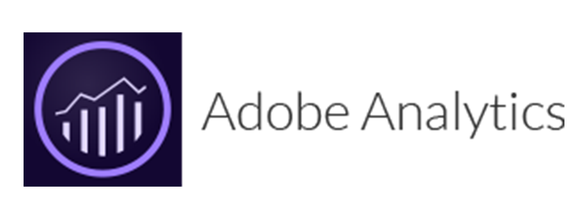
Table of Contents
Team Husky
Understand the objectives
Conclusions
Analysis Process
MLB Website
At Bat Apps (iOS & Android)
Recommendations
ADOBE ANALYTICS CHALLENGE
2
Notes:
We wish to explore the MLB data by using Adobe Analytics to tell a story.

Slide 3




Team Husky
ADOBE ANALYTICS CHALLENGE
Fan Bu
MS in Information Systems
Ruoyu Wang
MS in Business Analytics
Xuemeng Wu
MS in Business Analytics
3
Notes:
We are a team from University of Washington Seattle campus, all three of us are from the Foster School of Business specialized MBA programs.
Through Adobe Analytics Challenge, we hope to learn about Adobe Analytics and gain real-life data analytical experiences.

Slide 4

Understand the objectives
“How can MLB bring a beloved in stadium experience, and create the same excitement and personalized touch online?”
What are consumers seeking from the MLB online platforms (website, At Bat apps)?
How to utilize the online platforms to amplify MLB experience and generate revenue?
4
Notes:
On the AAC FAQ notes, it was mentioned that “The team's primary questions are: What is it that people are coming to our digital properties for? And then once they are there, what pages/actions/behaviors tend to move a user from MLB.com/Club sites/At Bat apps into the ticket purchase funnel?”
Therefore we took a step further and tried to understand the main objectives by using our own words.

Slide 5


Conclusions
Ticket is the major source of revenue for MLB
Purchasers tend to search and buy directly from the third-party ticketing websites (Tickets.com & Ticketmaster)
If a consumer intends to purchase tickets, he/she would not spend much time on browsing other sites on MLB.com
Game wrappers, live scoreboard, and news articles are some important functions drive customers to Atbat mobile app.
Some features in AtBat Android need to be improved.
ADOBE ANALYTICS CHALLENGE
5
Notes:
AtBat iOS Version has much higher premium purchase rate than Android one.
Checking scoreboard, game schedules, and game previews are convenient on mobile apps.

Slide 6
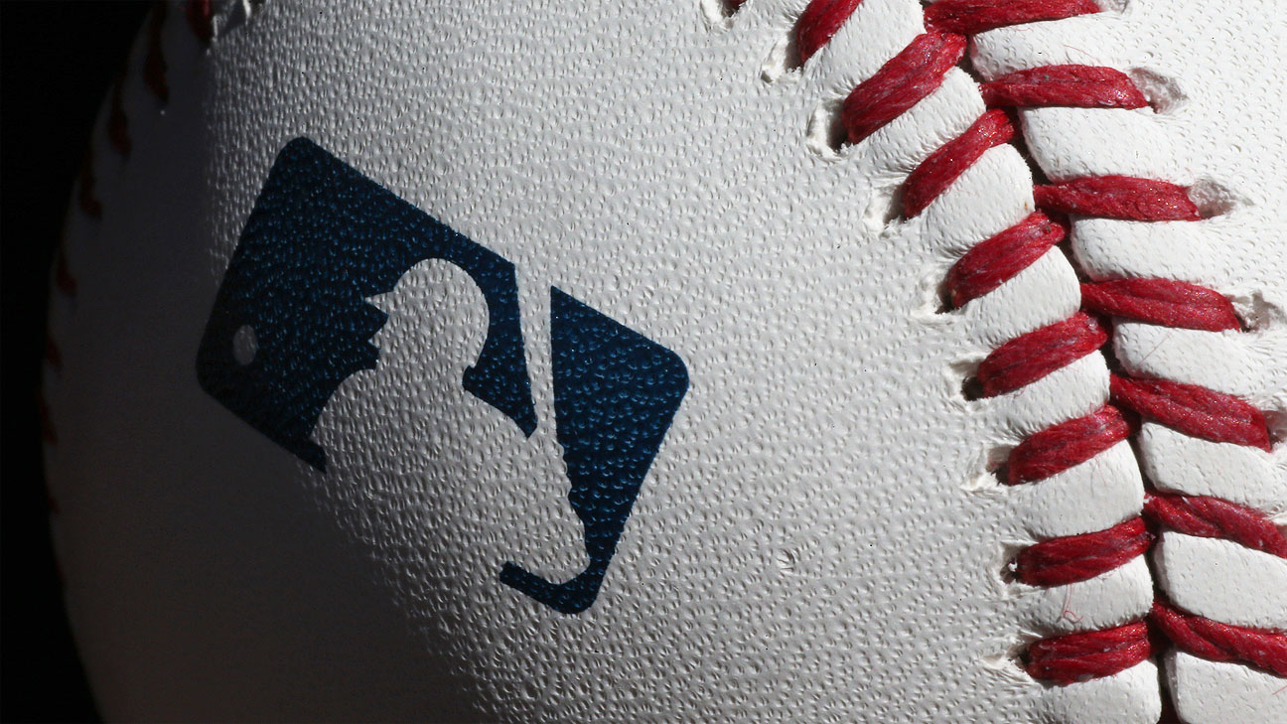

Analysis Process
Scope
Time: Jan 1st –Sept 30th 2019
Two Channels Three Data Sets:
Website: MLB Global
Mobile apps: iOS, Android
Metrics：
Visits
Pages
ADOBE ANALYTICS CHALLENGE
6

Slide 7
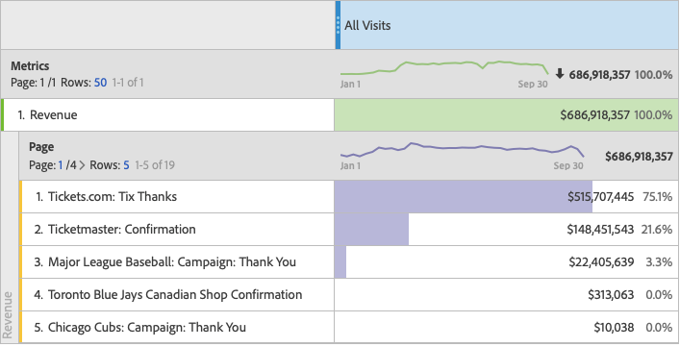
MLB Global – Revenue Sources
Major sources of Revenue:
Ticket purchase
Tickets.com 75%
Ticketmaster 21%
MLB Campaign 3.3%
Team Campaigns <1%
ADOBE ANALYTICS CHALLENGE
Purchaser Behaviors:
Directly from Tickets.com
From MLB.com
Homepage
Game Wrapper
Articles
Average time on site < 3 mins
7
Notes:
From the MLB Global data set, we wanted to know what are the major sources of revenue. Looking from the free form above, about 96% of the revenue comes from ticket purchasing through Tickets.com and Ticketmaster.
To take a closer look, we investigated what type of pages lead customers to purchase tickets. By using Purchaser segments on page visits, we found out that most ticket purchases come directly from Tickets.com. And most purchases made on MLB.com are led from homepage, game wrapper, and articles. In addition, if the consumer intends to make a purchase, he/she would not spend much time browsing the website.

Slide 8


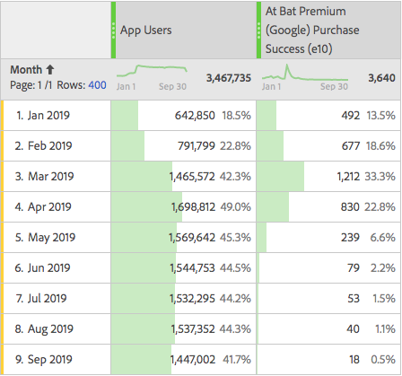
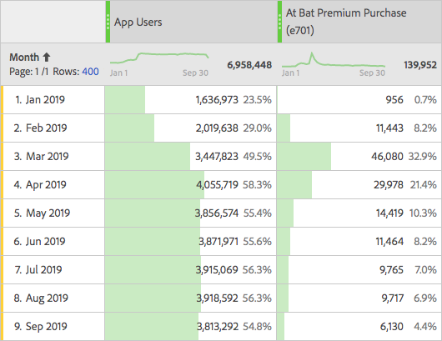
AtBat App– Users & Premium Purchases
iOS | Android
Purchase Rate: 2.01% | Purchase Rate: 0.11%
ADOBE ANALYTICS CHALLENGE
8
Notes:
The number of ATBat IOS users is roughly twice the number of ATBat Android users. It is a fact that the number of iphone users are more than the number of Android devices users. The important thing is that people using iphone are more likely to purchase premium package.
Possible Reasons:
ATBat Android has lower performance quality than ATBat IOS
The subscribe button in ATBat Android is hard to find
IOS users are more likely to spend money on entertainment/leisure

Slide 9
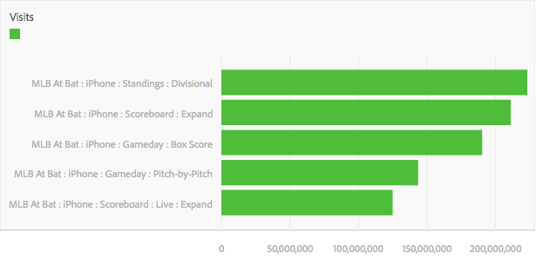
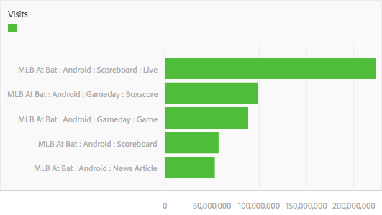
AtBat App– Usage (Top 5 Visiting Pages)
iOS
Focus on game standings, scores, summary
ADOBE ANALYTICS CHALLENGE
Android
Have much more passion on live games.
News Articles also attract a lot of Android app users.
9
Notes:
From the MLB Global data set, we wanted to know what are the major sources of revenue. Looking from the free form above, about 96% of the revenue comes from ticket purchasing through Tickets.com and Ticketmaster.
To take a closer look, we investigated what type of pages lead customers to purchase tickets. By using Purchaser segments on page visits, we found out that most ticket purchases come directly from Tickets.com. And most purchases made on MLB.com are led from homepage, game wrapper, and articles. In addition, if the consumer intends to make a purchase, he/she would not spend much time browsing the website.

Slide 10
Recommendations
Collaborating more with third-party ticketing websites to advertise MLB games
Within MLB.com, focusing ticket sales on homepage, articles, and game wrapper.
ADOBE ANALYTICS CHALLENGE
ADOBE ANALYTICS CHALLENGE
10
Notes:
Collaborating more with third-party ticketing websites to advertise MLB games
Within MLB.com, focusing ticket sales on homepage, articles, and game wrapper.

Slide 11
Recommendations
Improve subscription service for Android users by:
Redesigning the “Subscribe button” to make it visible at all times or, at least, easily accessible from the header or footer.
Offering 30 days free trial.
Offering a premium discount for users who spent a specific amount time on At Bat.
ADOBE ANALYTICS CHALLENGE
ADOBE ANALYTICS CHALLENGE
10

Slide 12

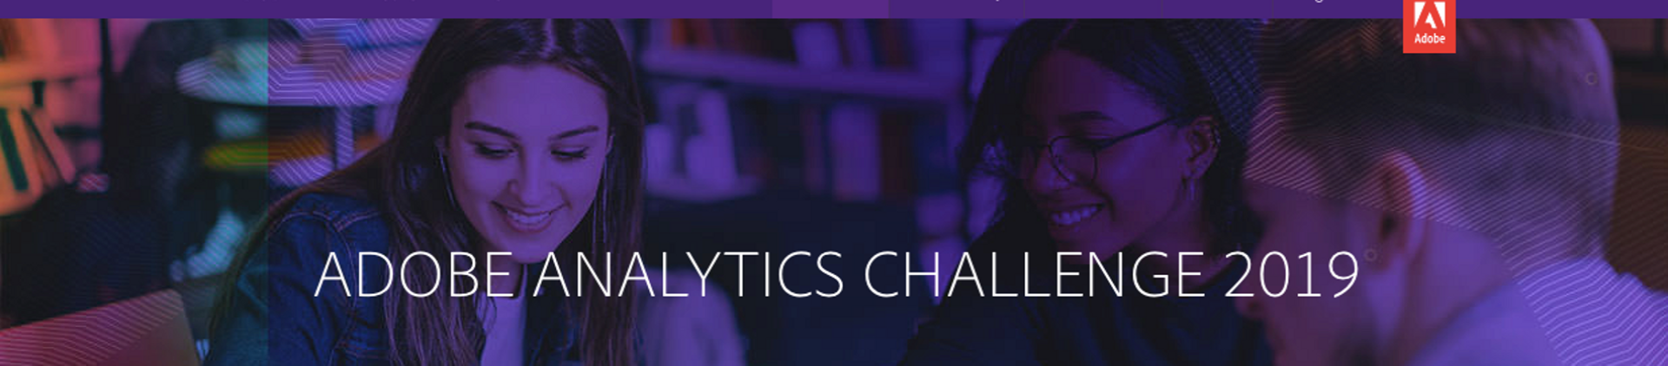
Thank You!

